Slide 1



DC Link Capacitor Optimization for Integrated Modular Motor Drives
The 26th IEEE International Symposium on Industrial Electronics
Mesut Uğur
ugurm@metu.edu.tr
Department of Electrical and Electronics Engineering
Middle East Technical University
21.06.2017

Slide 2
Outline
Introduction
IMMD Technology Review
DC Link Modeling
DC Link Capacitor Evaluation
Results
Conclusions
References

Slide 3
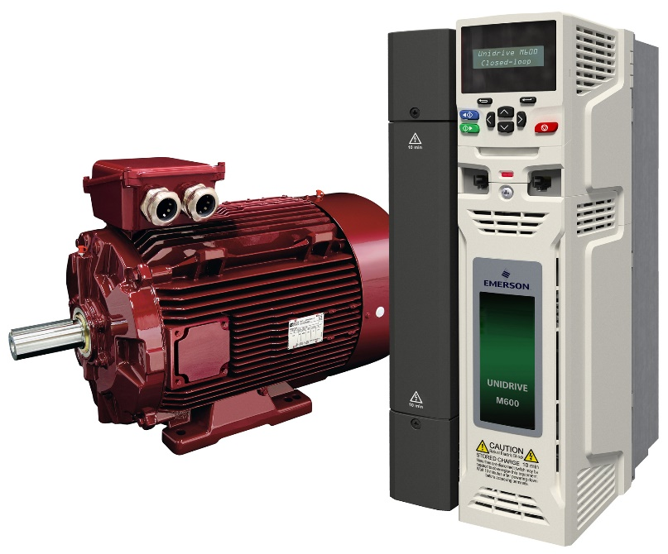
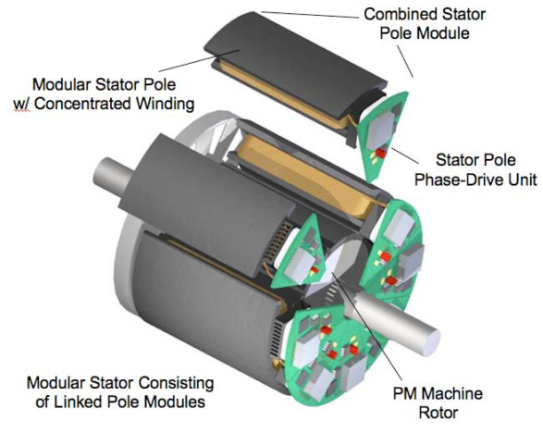
Introduction
Drives are placed in a separate cabinet
Increased volume, weight and cost
Connection with long cables
Long cable effect, EMI problems
The motor drive is integrated to the motor
Both the motor and the drive are modularized
http://www.emersonindustrial.com

Slide 4
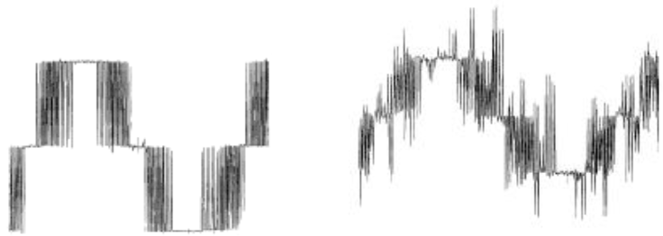
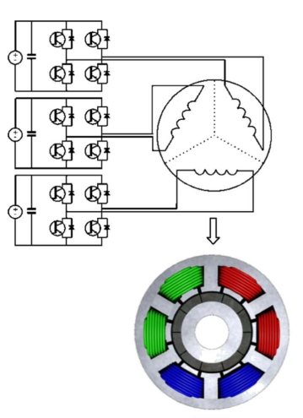
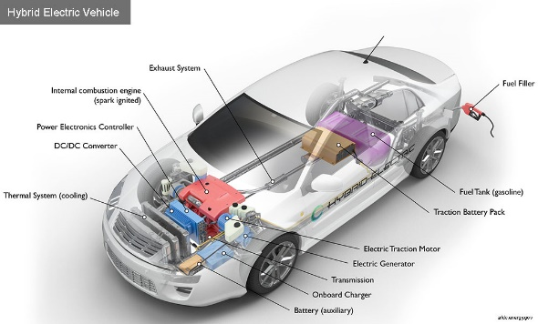
IMMD Technology Review
Motivation
Power density
Voltage overshoots
Motor lifetime
Increased fault tolerance
Distributed heat dissipation
Reduced voltage stress
Critical Applications
Electric traction: EVs, HEVs, Trains
Aerospace: Aircrafts, Space crafts
https://www.afdc.energy.gov/vehicles/how-do-hybrid-electric-cars-work

Slide 5
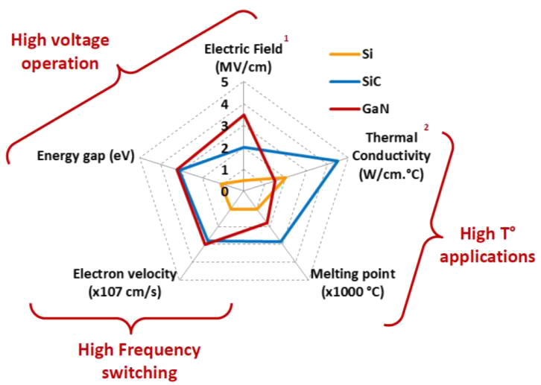
IMMD Technology Review
Challenges
Small volume ?
Cooling ?
Vibration ?
Gallium Nitride (GaN)
Wide band-gap (WBG) power semiconductor devices
Low loss: heat sink size is reduced
High speed: passive component size is reduced

Slide 6
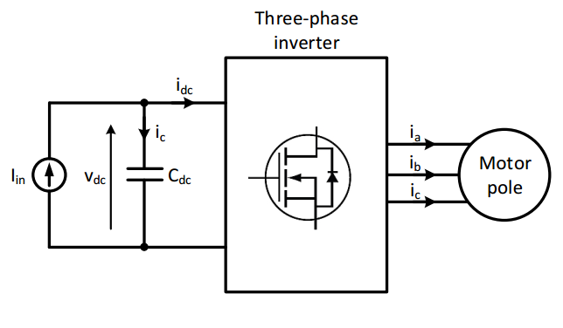
DC Link Capacitor Selection
Motivation
DC link capacitors constitute
20% of cost and weight
30% of volume
DC Link model
Critical parameters
Capacitance requirement
RMS current
Thermal characteristics
Reliability & lifetime
Mechanical durability

Slide 7
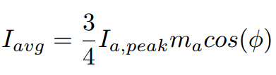
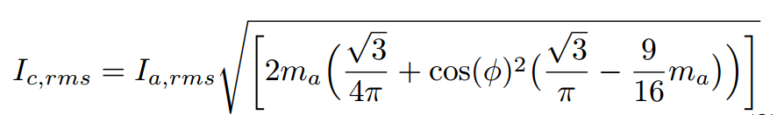
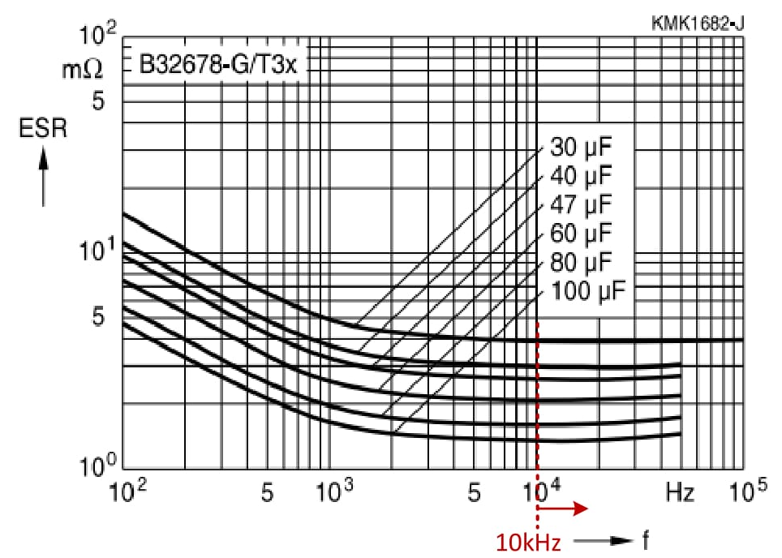

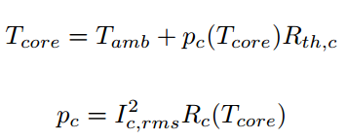
DC Link Modeling
Analytical model

Slide 8
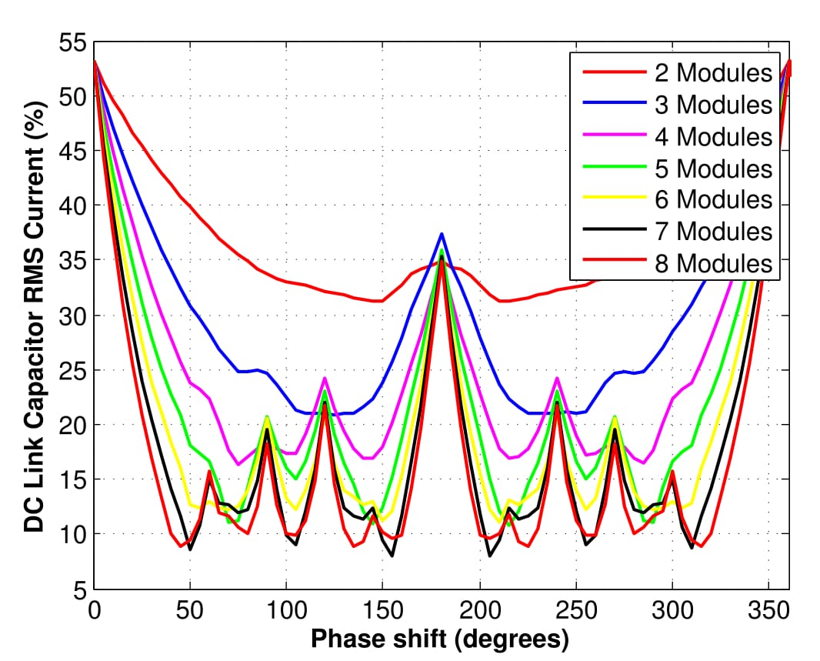
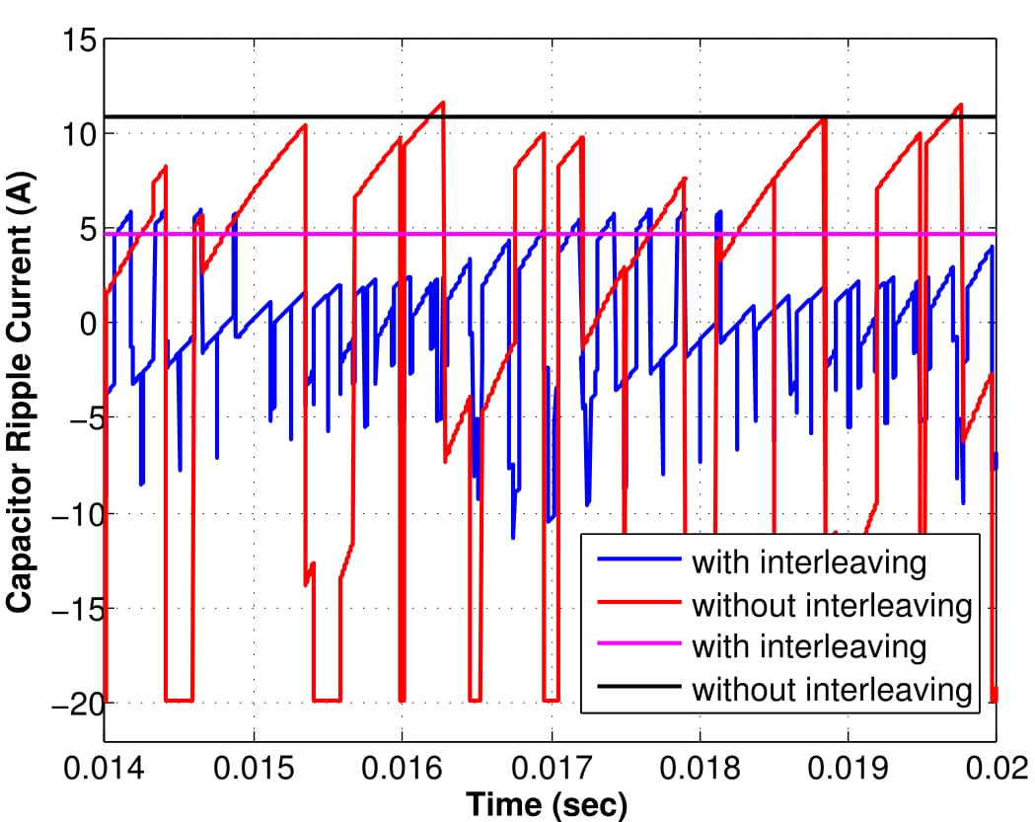

DC Link Modeling
Effect of interleaving
Minimum RMS current is achieved at $\frac{2π±π/3}{n}$ for even number
It is not practical to use number of modules higher than 4

Slide 9
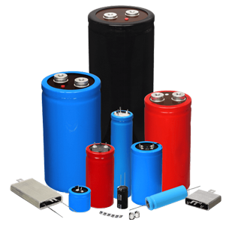

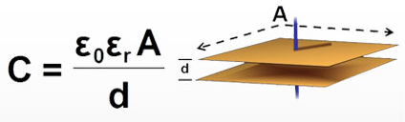

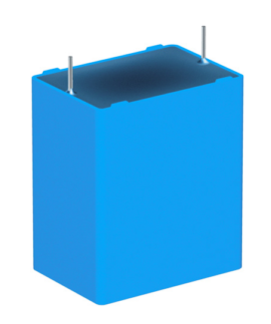
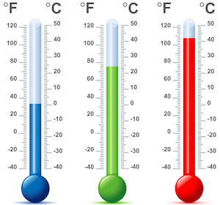

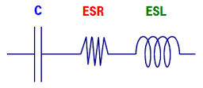
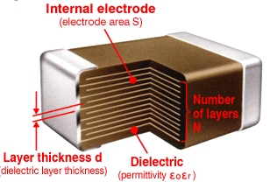
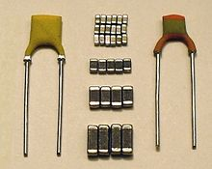
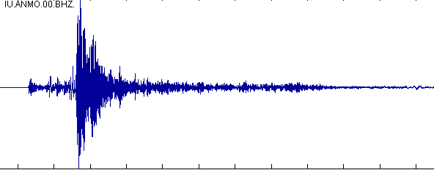
DC Link Capacitor Evaluation
DC Link capacitor types
Aluminum Electrolytic Capacitors
Metallized Polypropylene Film Capacitors
Multi-Layer Ceramic Capacitors (MLLC)

Slide 10
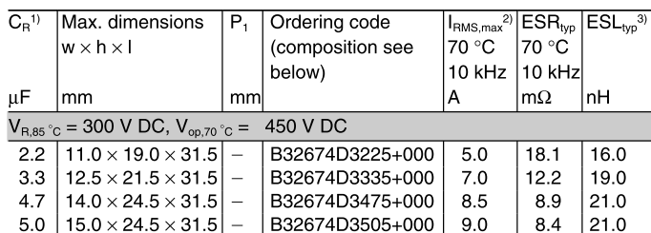
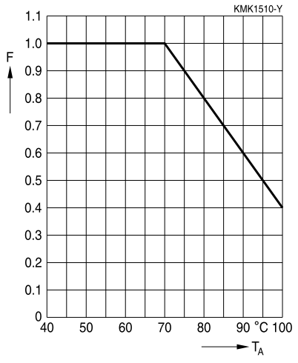
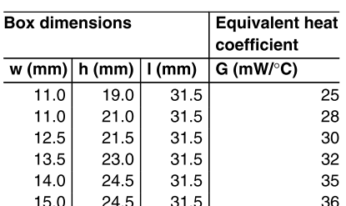
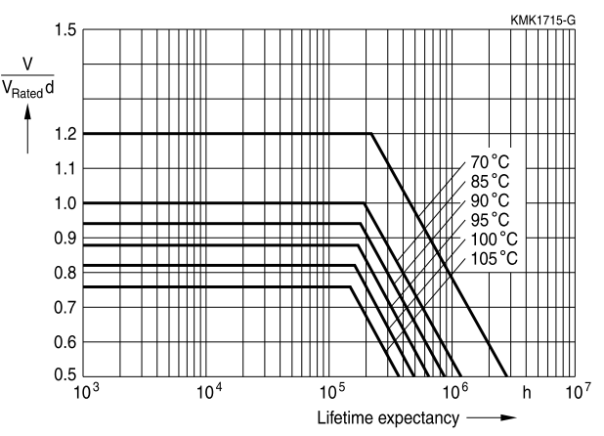
DC Link Capacitor Evaluation
Capacitor selection aspects
The basic parameters
• Capacitance due to voltage ripple
• RMS current due to current ripple
• Voltage due to topology
The major concerns
• High power density
• Low height
• Low cost
• Low temperature sensitivity
• Mechanical durability
• Lifetime
Metallized Polypropylene Film Capacitors
https://en.tdk.eu/inf/20/20/db/fc_2009/MKP_B32674_678.pdf

Slide 11
DC Link Capacitor Evaluation
Capacitor selection algorithm

Slide 12
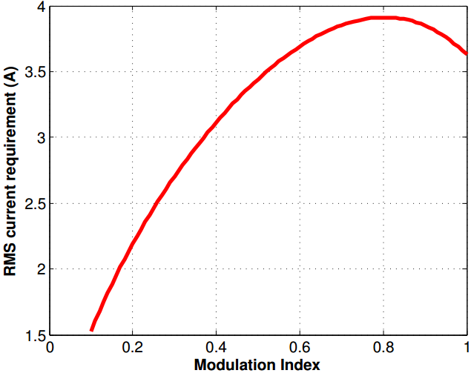
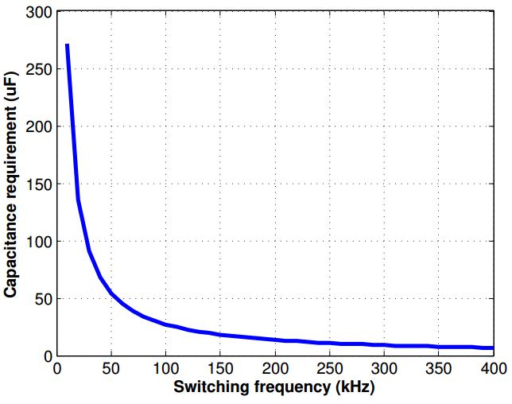
Results
System Parameters |  | Constraints
Power factor | 0.9 | Power density | 10W/cm³
V_{dc} | 400V | Cost | 35$
Phase shift | 90⁰ | Height | 35mm
Power per module | 2kW | Temp. rise | 5 ⁰C
Ambient temp. | 40 ⁰C | V_{dc,r,pp} | 1%
RMS current vs m_{a}
Capacitance vs f_{sw}
Max. RMS current
Only 30% reduction from 100kHz to 200kHz

Slide 13
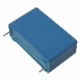
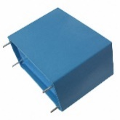



Results
10 μF, 300 V
2s, 10p
High cost
Low power density
40 μF, 300 V
2s, 3p
40 μF, 450 V
1s, 2p
Moderate cost
Low power density
Height
Height
High temp. rise
High power density
Low cost
Low height
Low temp. rise
20 μF, 450 V
1s, 4p

Slide 14
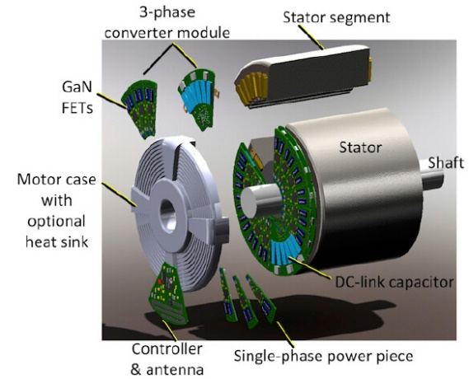
Conclusions
Size reduction challenge
Passive components and heatsink
GaN FETs
Optimize the DC bus capacitor bank
Power density !
Interleaving is applicable
Optimum number of modules
Film capacitors are suitable
Consider all the aspects
Switching frequency limit
Sonuçlarla ilgili yorumlar

Slide 15
Conclusions
Integrated modular motor drives
Advantages and challenges
Volume reduction challenge
DC link capacitor size optimization
DC Link model of an IMMD
Critical parameters
Analytical model
Interleaving
Optimum phase shift angle
Optimum number of modules
Capacitor selection algorithm
Film capacitors => datasheet parameters
Critical switching frequency
Case results => optimum combination

Slide 16
References
G. Lo Calzo et al., “Integrated motor drives: state of the art and future trends,” IET Electr. Power Appl., vol. 10, no. 8, pp. 757–771, Sep. 2016.
J. Wang, Y. Li, and Y. Han, “Integrated Modular Motor Drive Design With GaN Power FETs,” IEEE Trans. Ind. Appl., vol. 51, no. c, pp. 3198–3207, 2015.
J. J. Wolmarans, M. B. Gerber, H. Polinder, S. W. H. De Haan, J. A. Ferreira, and D. Clarenbach, “A 50kW integrated fault tolerant permanent magnet machine and motor drive,” PESC Rec. - IEEE Annu. Power Electron. Spec. Conf., pp. 345–351, 2008.
N. R. Brown, T. M. Jahns, and R. D. Lorenz, “Power Converter Design for an Integrated Modular Motor Drive,” Ind. Appl. Conf. 2007. 42nd IAS Annu. Meet. Conf. Rec. 2007 IEEE, pp. 1322–1328, 2007.
S. M. Lambert, B. C. Mecrow, R. Abebe, G. Vakil, and C. M. Johnson, “Integrated Drives for Transport - A Review of the Enabling Electronics Technology,” IEEE Veh. Power Propuls. Conf., pp. 1–6, 2015.
A. Shea and T. M. Jahns, “Hardware integration for an integrated modular motor drive including distributed control,” in 2014 IEEE Energy Conversion Congress and Exposition (ECCE), 2014, pp. 4881–4887.

Slide 17


Thank you !
Mesut Uğur
ugurm@metu.edu.tr
Department of Electrical and Electronics Engineering
Middle East Technical University

